Slide 1

KAMESH KHANDEKAR
2022-03-29

Slide 2

Outline
Executive Summary
Introduction
Methodology
Results
Conclusion
Appendix

Slide 3
Executive Summary
Summary of methodologies :
Collect data from public SpaceX API and its Wikipedia page.
Created labels column “class”, which classifies the successful landings.
Explored and visualize data using SQL, visualization, folium maps, and dashboards.
Gathered relevant columns to be used as features.
Used one hot encoding to change all categorical variables to binary. Standardized data and used GridSearchCV technique to find the best parameter for machine learning models.
Visualize accuracy score of all models.
Summary of all results
Four machine learning models were produced:
Logistic Regression, Support Vector Machine, Decision Tree Classifier, and K Nearest Neighbors.
All produced similar results with accuracy rate of about 83.33%. All models over predicted successful landings. It requires more data to make model better and for better model determination and accuracy.

Slide 4
Introduction
Project background and context
SpaceX(Space Exploration Technologies Corp.) is developing a satellite internet constellation named Starlink to provide commercial internet service.
Founded in 2002 by Elon Musk.
Reducing space transportation cost with pricing from $165 million USD to $62 million USD.
It has best pricing compared to other space providers.
The project is for SpaceY which wants to compare with SpaceX.
Problems you want to find answers
SpaceY is working to train a machine learning model to predict successful recovery of stage 1 from rockets.

Slide 5

Section 1

Slide 6
Methodology
Executive Summary
Data collection methodology:
The combination of data from SpaceX API and the Wikipedia of SpaceX page.
Perform data wrangling
Data is transformed and mapped from one raw data form into another form with intent of making it more appropriate and valuable for various tasks.
Perform exploratory data analysis (EDA) using visualization and SQL
Perform interactive visual analytics using Folium and Plotly Dash
Perform predictive analysis using classification models
Build : training data and Training labels, tune : GridSearchCV, evaluate classification models : cross-validation and feature extraction.

Slide 7
Data Collection
Data collection process involved in a combination of SpaceX API and Wiki pages’ data via web scrapping from tables in the wiki page.
Then in next slide will show the flowchart of data collection from SpaceX API and after that it will show flowchart of data collection from web scrapping using Beautiful Soup.
SpaceX Api columns after parsing the request data :
Serial, Longitude, Latitude, PayloadMass, Orbit, LaunchSite, Outcome, Flights, Legs, FlightNumber Date, BoosterVersion, LandingPad, Block, ResusedCount, GridFins, Resused
SpaceX Api columns after parsing the request data :
Orbit, Customer, FlightNo, LaunchSite, Payload, BoosterLanding, Date, Time, PayloadMass, LaunchOutcome, VersionBooster

Slide 8
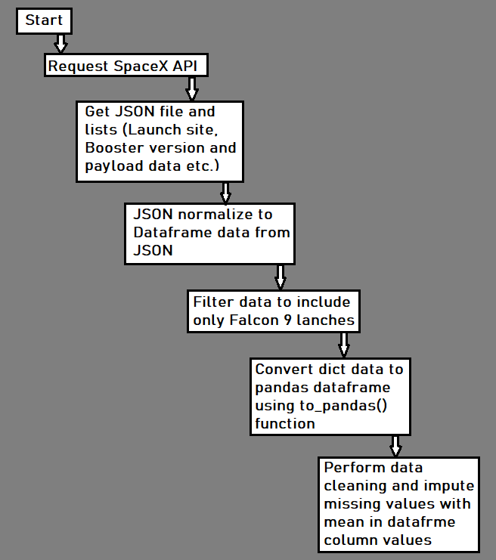
Data Collection – SpaceX API
Presented data collection with SpaceX REST calls using key phrases and flowcharts :
Kindly, refer to figure shown on right side.
GitHub URL of the completed SpaceX API calls notebook :
https://github.com/kamesh01/Applied-Data-Science---Capstone/blob/main/Week%201%20Introducation/Capstone_Data_Collection_API.ipynb
Place your flowchart of SpaceX API calls here

Slide 9
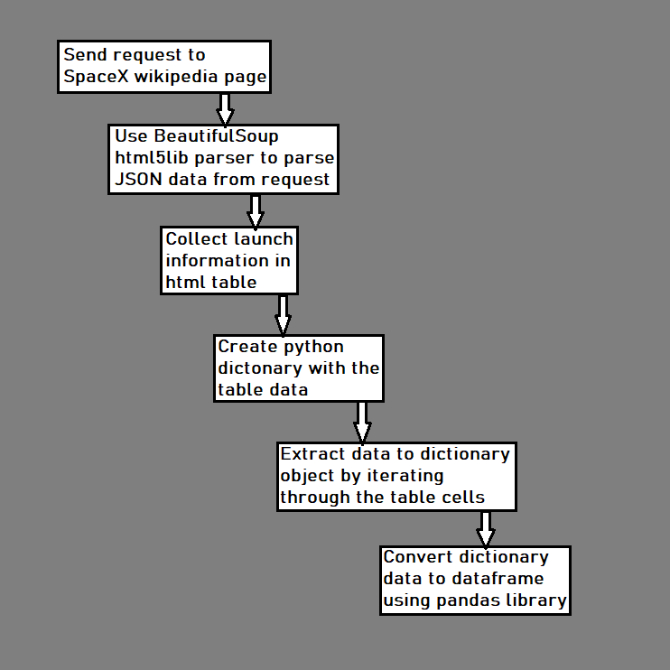
Data Collection - Scraping
Present your web scraping process using key phrases and flowcharts :
Kindly, refer to figure shown on right side.
GitHub URL of the completed web scraping notebook :
https://github.com/kamesh01/Applied-Data-Science---Capstone/blob/main/Week%201%20Introducation/Capstone_Data_collection_with_WebScrapping.ipynb
Place your flowchart of web scraping here

Slide 10
Data Wrangling
First create training label with landing outcomes where successful =1 & failure = 0. Outcome column has two components Landing location and missing outcomes.
Value mapping: new training label’s column “Class” with a value of 1 if missing outcome is True else 0 for false value.
Ex. – There are two situations :
True ASDS, True RTLS & True Ocean set to 1
False ASDS, None None, False RTLS set to 0
GitHub URL of your completed data wrangling related notebooks :
https://github.com/kamesh01/Applied-Data-Science---Capstone/blob/main/Week%201%20Introducation/Capstone_Data_wrangling_EDA_.ipynb

Slide 11
EDA with Data Visualization
Exploratory data analysis(EDA) is an approach of analyzing data sets to summarize their main characteristics, often using statistical graphics and other data visualization methods. A statistical model can be used or not, but primarily EDA is for seeing what the data can tell us beyond the formal modeling or hypothesis testing task.
Plots used and why :
Scatter plots, line plots and bar plots are used to explore the relationship between different variables to decide if a relation exists, so that it could be used in training the machine learning models and get idea about data using visualization.
GitHub URL of your completed EDA with data visualization notebook :
https://github.com/kamesh01/Applied-Data-Science---Capstone/blob/main/Week%202%20EDA/EDA_with_Data_Visualization.ipynb

Slide 12
EDA with SQL
Summarizing the SQL queries are performed :
Created table and loaded data in DB2 database.
Used SQL python integration using notebook and SQL Alcamy.
Used where clauses to filter the records from dataset.
Retrieved launch site name, various payload sizes, booter version info and landing outcomes.
Used date range to get information(in some date range) of different parameters like outcomes, launch site name and others.
GitHub URL of your completed EDA with SQL notebook :
https://github.com/kamesh01/Applied-Data-Science---Capstone/blob/main/Week%202%20EDA/EDA_with_SQL.ipynb

Slide 13
Build an Interactive Map with Folium
Summary of what map objects such as markers, circles, lines, etc. that’s been created and added to a folium map :
In folium maps, makers are used for Launch site, successful and unsuccessful landings location with proximity key locations can be any of Railway, Highway, Coast and city or near to it.
These markers provides ease and allows us to understand better to which location is best fit to launch sites. Visualization helps in finding successful landing to its corresponding locations.
GitHub URL of your completed interactive map with Folium map :
https://github.com/kamesh01/Applied-Data-Science---Capstone/blob/main/Week%203%20Interactive%20Visual%20Analytics%20and%20Dashboard/Interactive_Visual_Analytics_with_Folium_lab.ipynb

Slide 14
Build a Dashboard with Plotly Dash
The dashboard includes a pie chart and a scatter plot.
The Pie chart is useful to show distribution of successful landings across all launch sites and individual launch site success rates with distributed visual.
The pie-chart is used to visualize launch site success rate.
In Scatter plot it takes two input : All sites or individual site and payload_mg on a slider between 0 to 10000 kg.
The scatter plot is used to see how success varies across launch sites, payload_mg, and booster version category.
GitHub URL of your completed Plotly Dash lab :
https://github.com/kamesh01/Applied-Data-Science---Capstone/blob/main/Week%203%20Interactive%20Visual%20Analytics%20and%20Dashboard/spacex_dash_app.py

Slide 15
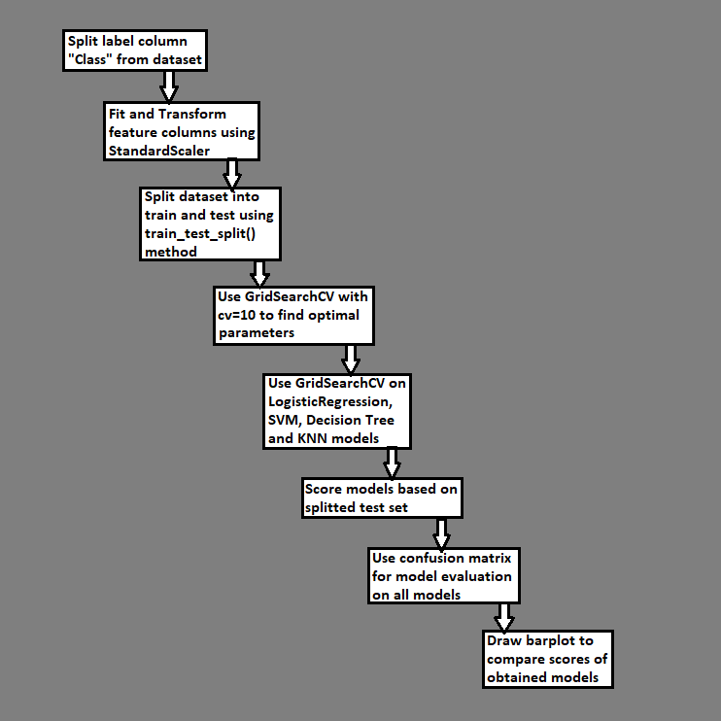
Predictive Analysis (Classification)
Build model using different algorithms like SVM, KNN, Decision tree, Logistic regression.
Use GridSearchCV with cv =10 parameter, to find the best hyperparameter to get the best parameter for model for highest accuracy.
Use scoring method to score each built models based on the splitted test dataset.
For model evaluation, use confusion matrix on each generated models.
Draw barplot and visualize the score for better efficiency/accuracy of each model.
For key phrases and flowchart refer figure to right side.
GitHub URL of your completed predictive analysis lab :
https://github.com/kamesh01/Applied-Data-Science---Capstone/blob/main/Week%204%20Predicative%20Analysis%20-%20Classification/Machine_Learning_Prediction.ipynb

Slide 16
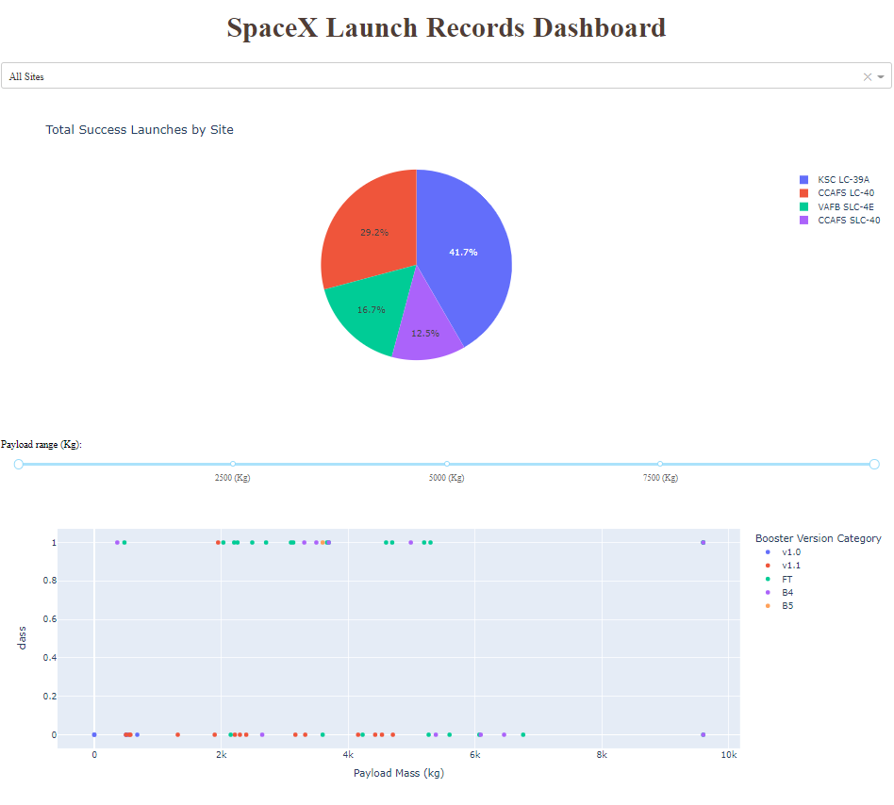
Results
The figure shown on right side is the Plotly Dashboard with a Pie Chart and a Scatter Plot.
In the coming slides, will see the results of EDA with visualization, EDA with SQL, Interactive Map with Folium and finally the results of our model with about 83% accuracy.

Slide 17

Section 2

Slide 18
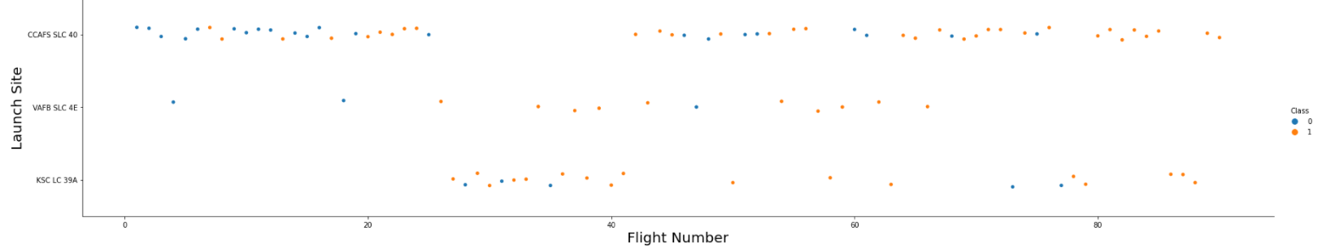
Orange color indicates : Successful launches Blue color indicates : Unsuccessful launches
Flight Number vs. Launch Site
The above graph suggests an increase in success over time.
Likely a big breakdown around flight 20 which significantly increased success rate.
CCFA appears to be the main launch site as it has the most volume in green color.

Slide 19
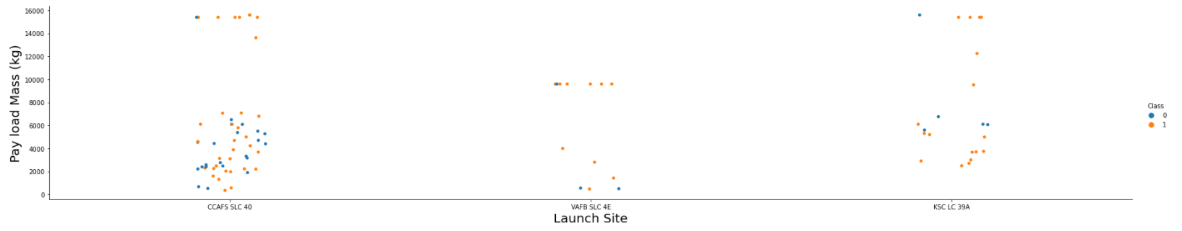
Payload vs. Launch Site
Orange color indicates : Successful launches Blue color indicates : Unsuccessful launches
By observing Payload Vs. Launch Site scatter point chart, will find for the VAFB-SLC LaunchSite there are no rockets launched for HeavyPayload_Mass(greater than 10000).

Slide 20
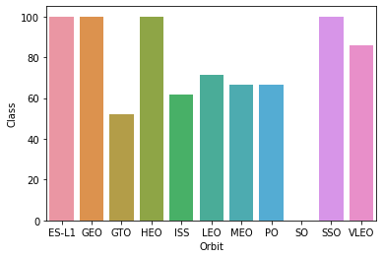
Success Rate vs. Orbit Type
Success rate scale with
0%
60%
100%
Orbit types : ES-L1, GEO, HEO and SSO has 100% success rate, GTO has 50% success rate, LEO has 40% decent success rate, SO has 0(0% success rate)

Slide 21
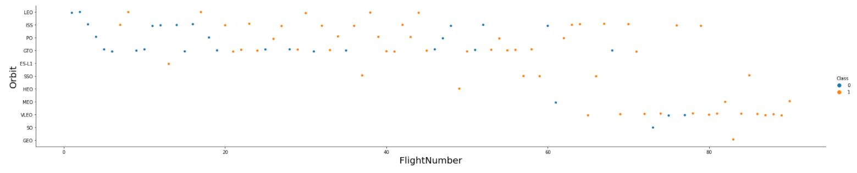
Flight Number vs. Orbit Type
Orange color indicates : Successful launches Blue color indicates : Unsuccessful launches
Launch orbit preferences changed over Flight Number.
Launch outcomes seems to correlate with this preference.
SpaceX started with LEO orbit which saw moderate success LEO.
Hence, the graph shows that SpaceX performs better in lower orbits synchronous orbits.

Slide 22
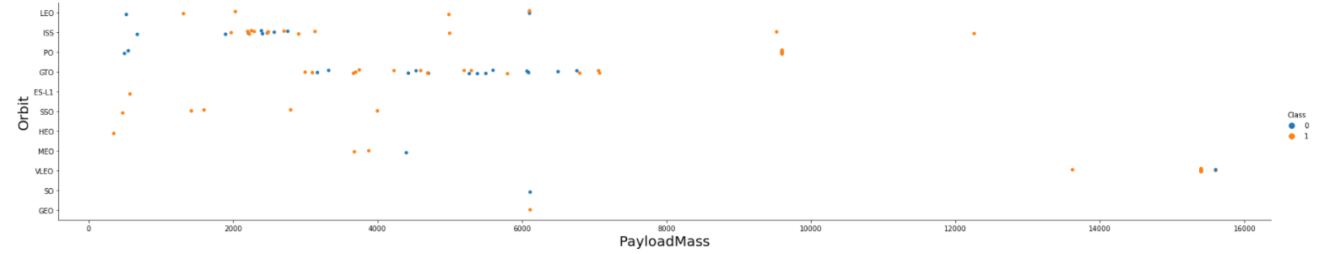
Payload vs. Orbit Type
With heavy payloads the successful landing or positive landing rate are more for Polar, LEO and ISS.
However for GTO we cannot distinguish this well as both positive landing rate and negative landing(unsuccessful mission) are both there here.
Payload mass seems to correlate with orbit.
SSO and LEO seems to have relatively low payload mass.

Slide 23
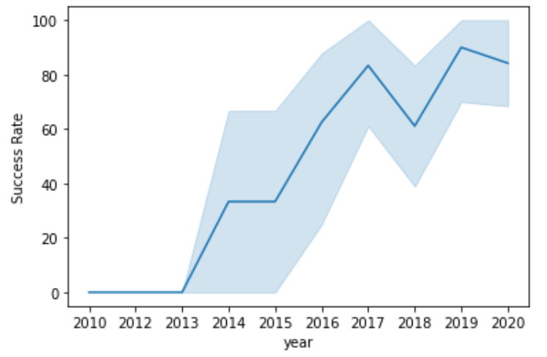
Launch Success Yearly Trend
From the figure it can be observed that the success rate, since 2013 kept increasing till 2020.
The success rate in year around 2019, it is highest that is 90%
Hence, it can be concluded that success generally increases over time since 2013.

Slide 24
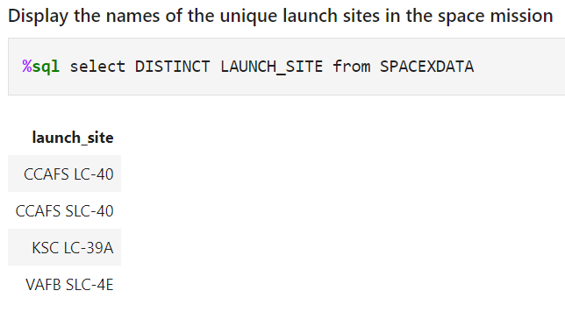
All Launch Site Names
The shown query is giving unique launch site names from database.
From looking at the figure, it is clear in understanding that there only 4 launch sites by SpaceX.
But CCAFS LC-40 and CCAFS SLC-40 looks same, it might be possible that there might be entry error.
So, if there is any entry error or typing mistake then, there are only 3 unique sites for launching SpaceX.

Slide 25
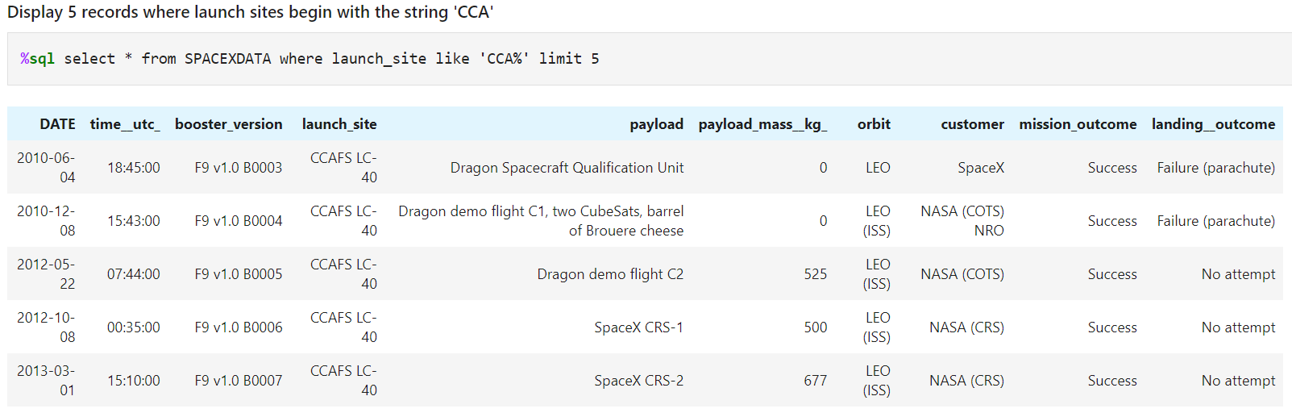
Launch Site Names Begin with 'CCA'
With the help of above query shown in figure, we can get only 5 records where launch sites begin with `CCA`.
Hence, we can understand that there some records in database with starting letters as ‘CCA’.

Slide 26
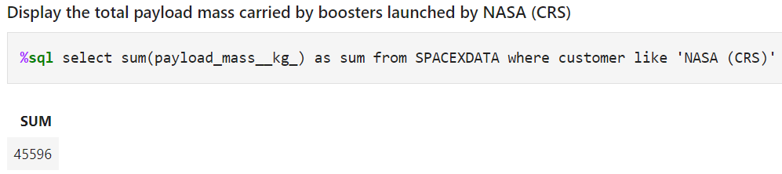
Total Payload Mass
The query adds all the payload mass kg where the customer was NASA.
From the output we can understand that NASA has been carried 45,596 boosters till now, as per the current database information.

Slide 27
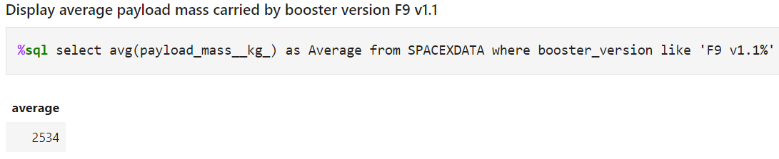
Average Payload Mass by F9 v1.1
The above query is calculating the average of payload mass kg of boosters with applying the filter with booster version which starts from ‘F9 v1.1’
Hence, it can be seen that average payload mass of F9 v1.1 has 2534 kg, which is quite low in payload mass range as per the current database.

Slide 28
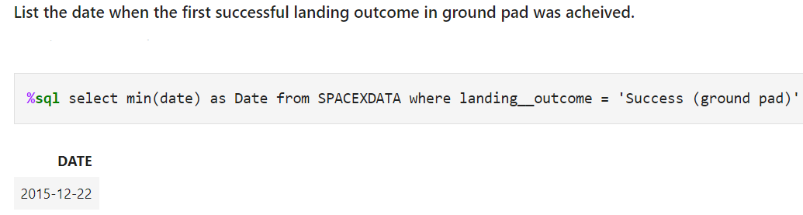
First Successful Ground Landing Date
The above query returns the first successful ground pad landing date.
First ground pad landing wasn’t until the end of 2015.
Successful landings in general appear starting on ending of 2014.

Slide 29
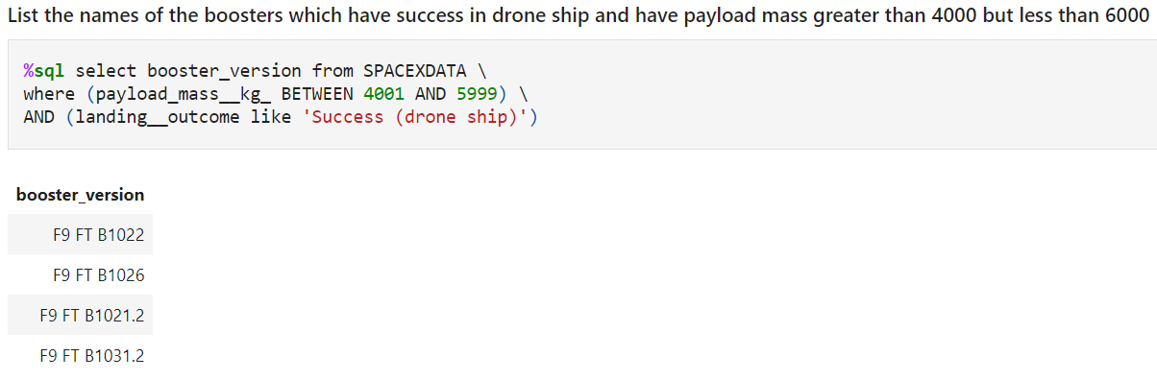
Successful Drone Ship Landing with Payload between 4000 and 6000
The query returns 4 successfully landed on drone ship and had payload mass greater than 4000 but less than 6000
The query exclude payload mass which is 4000 or 6000 but returns all the records between these range.

Slide 30
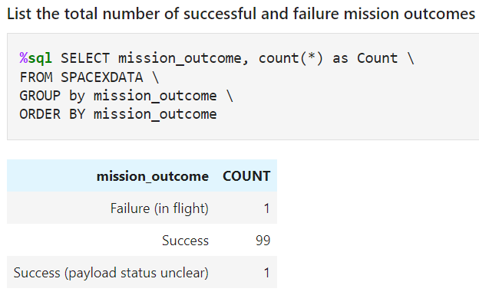
Total Number of Successful and Failure Mission Outcomes
The above query returns count of each mission outcome.
The result shows that SpaceX is having 99% success rate, it means that most of the landing failures are intended.
From the result, one launch has an unclear payload status and unfortunately one failure in flight.

Slide 31
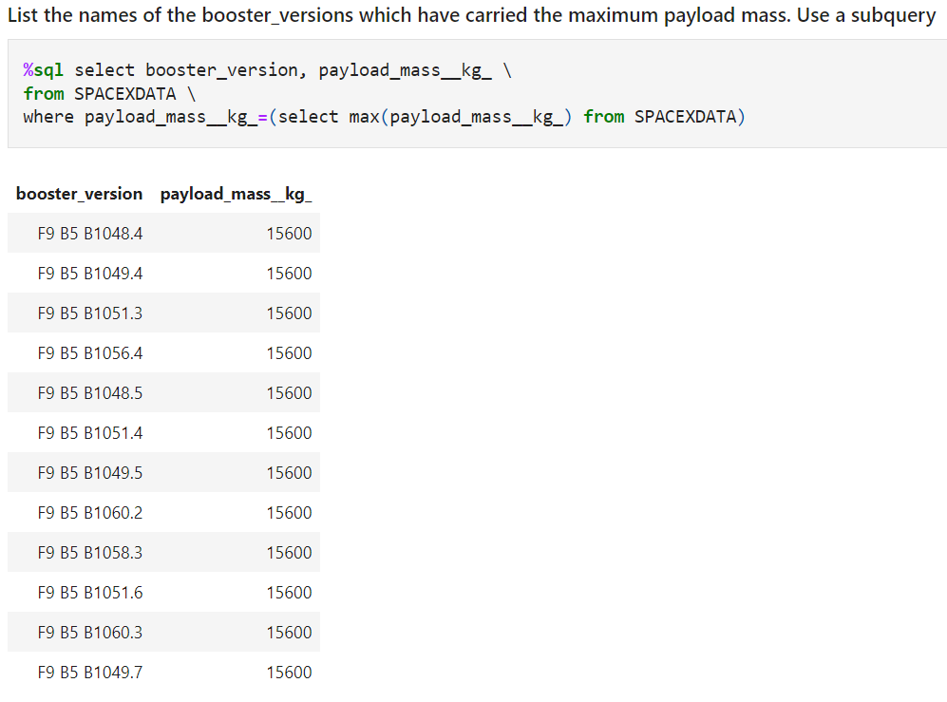
Boosters Carried Maximum Payload
The shown query returns the booster versions that carried the highest payload mass of 15600 kg
The booster F9 B5 B10 variety has similar booster versions.
This shows that payload mass correlates with the booster version that is being used.
It tells that F9 B5 B1… series has the highest payload mass capacity of boosters.

Slide 32
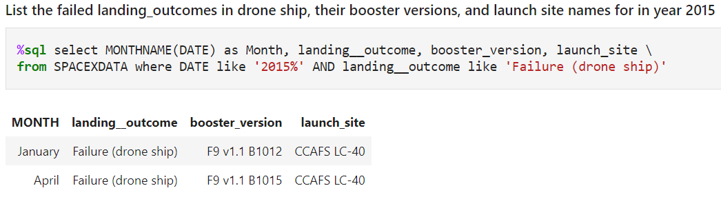
2015 Launch Records
The query returns the month, landing outcome, booster version, launch site which have launched on date 2015.
From the output it is clearly appeared that, in year 2015 stage 1 failed to land on a drone ship, one of those failure was in January, and one was in April.

Slide 33
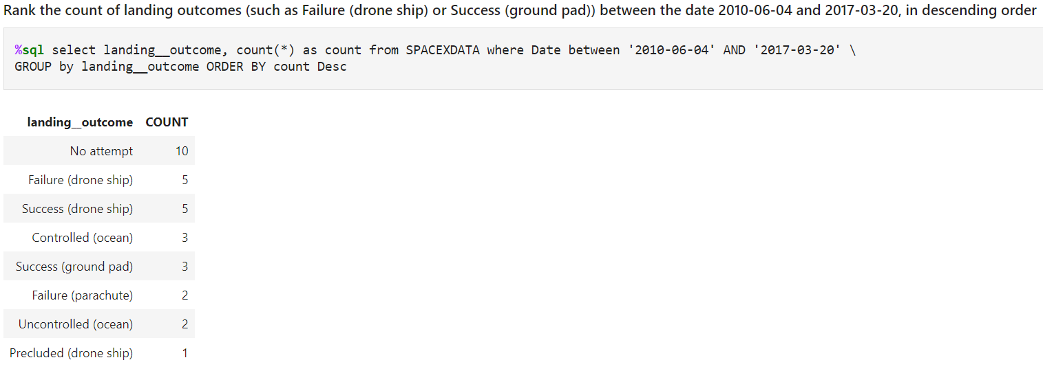
Rank Landing Outcomes Between 2010-06-04 and 2017-03-20
The query returns a list of counts and of all the landing outcome.
It includes success and failure and other type of landing outcome with a date range between 2010-06-04 and 2017-03-20.
After getting the records between the date range, it is sorted in descending order of count of landing outcome.

Slide 34

Section 3

Slide 35
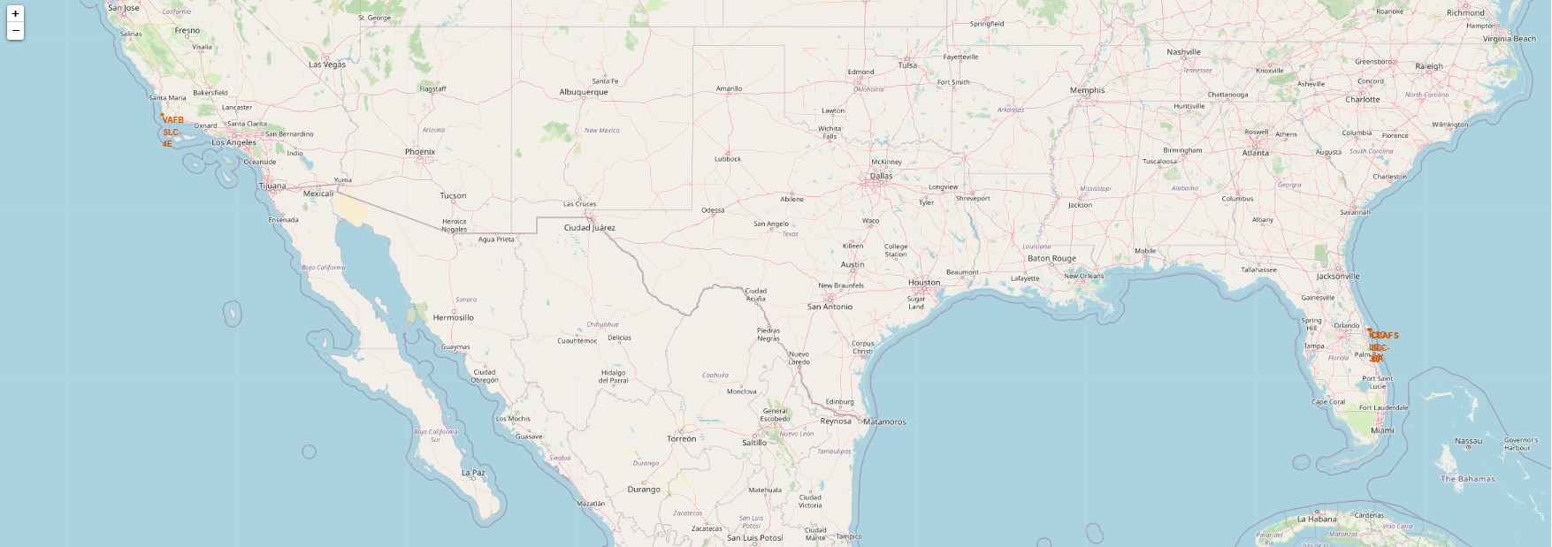
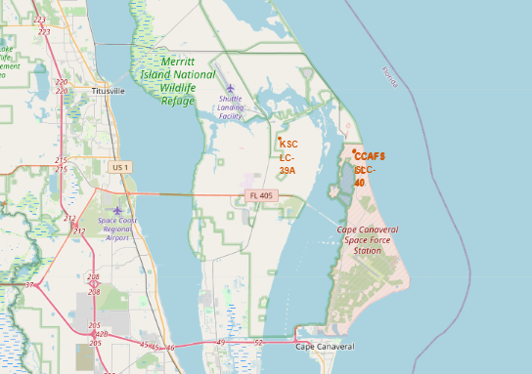
Launch Site Locations
The above map is showing all the launch site locations globally in US.
The left map is showing all launch sites relative to US map.
The right map is showing the two launch sites locations.
From the above map, all sites are near to ocean.

Slide 36
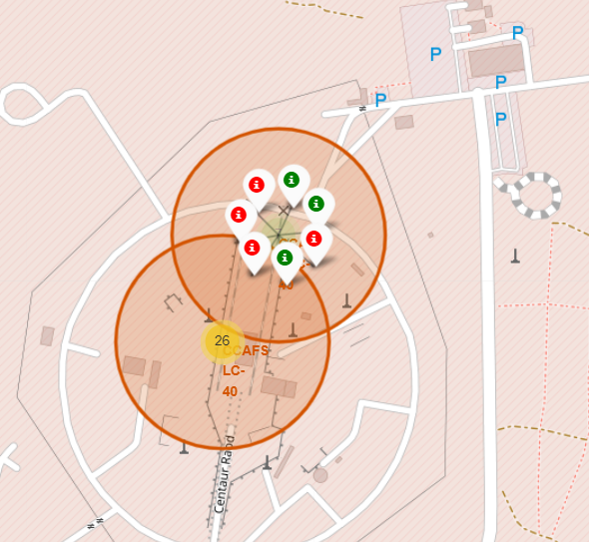
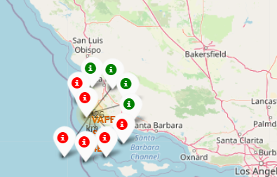
Success and failure launch sites color-coded markers
From the color-labeled markers in marker clusters, you should be able to easily identify which launch sites have relatively high success rates.
The clusters on folium map can be used to click on to display each successful(green color) and unsuccessful(red color) landing sites
In this top screenshot shows CCAFS SLC-40 has 3 successful landings and 5 unsuccessful landings.
In the bottom screenshot shows VAFB SLC-4E has 4 successful(green) and 6 unsuccessful landings(red).

Slide 37
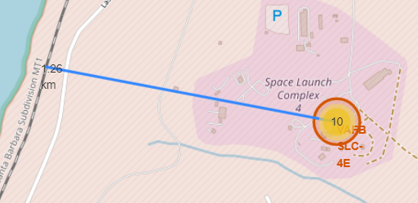
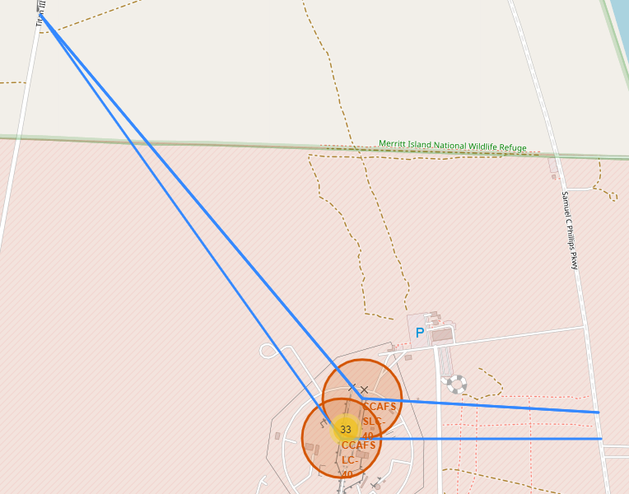
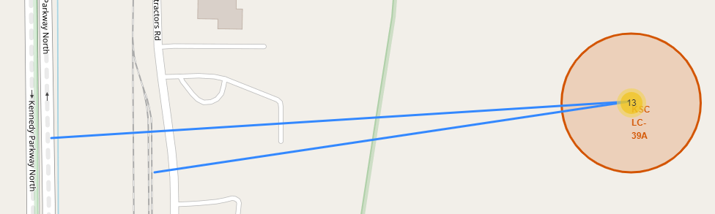
Distance between a launch site to its proximity locations
With proximity we can calculate the distance between two points on the map based on their Lat and Long values.
There are different launch sites by SpaceX, each launch site is showing distance from nearest railway, highway and city that is the major factor for transportation cost.
Launch sites are also closest to some coasts but distance from cities, so launch failure can land in the sea to avoid rockets falling on populated area.

Slide 38

Section 4

Slide 39
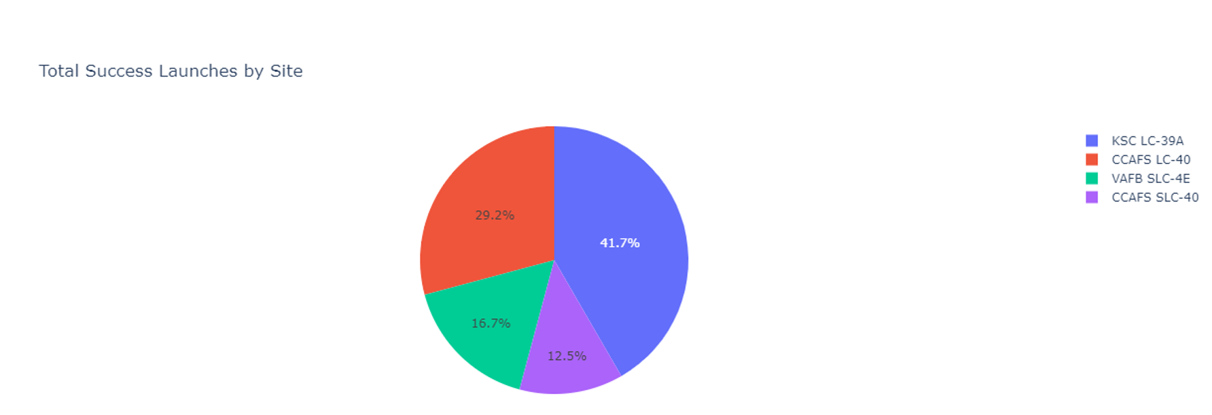
Successful launch sites – Across all launches
The pie chart is showing distribution of successful landings across all launch sites.
CCAFS LC-40 has most of the successful landings were performed.
CCAFS SLC-40 is new name for launch site so it can be ignored as a smallest distributor in successful launches. After CCAFS SLC-40 is ignored, VAFB SLC-4E is the smallest distributor in successful launch sites.

Slide 40
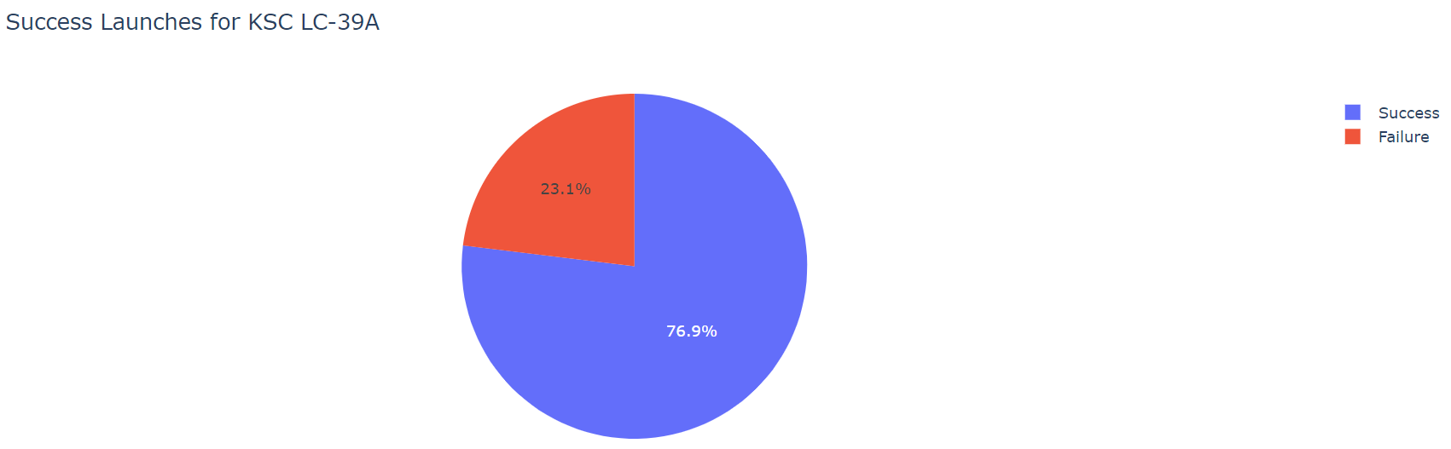
Highest launch success ratio
The pie chart shows that the launch site KCS LC-39A has the highest success rate with 76.9%
Blue color is for success ratio and Orange is for failure ratio.

Slide 41
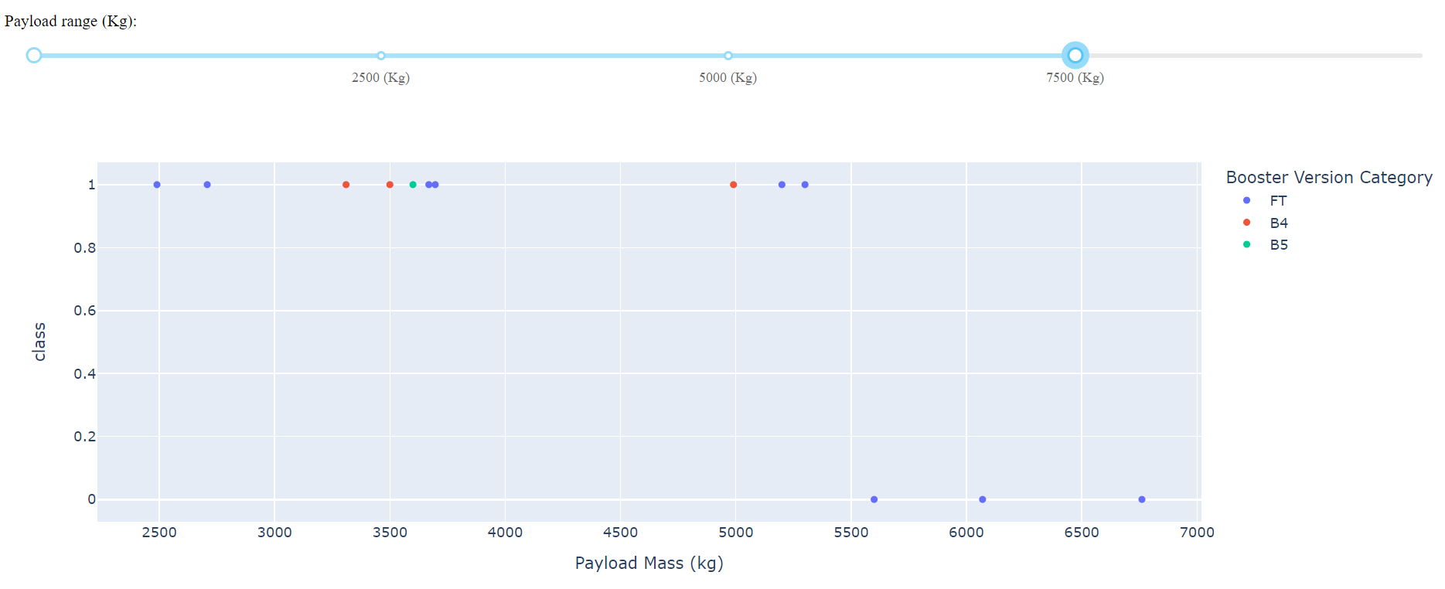
Payload vs. Launch Outcome with booster versions
Payload dashboard has a payload range selector. However, this is sent from 0-1 ratio.
In the dashboard it has option to slide for different payload mass, in the above screenshot 0-7500kg payload is showing.
There 3 booster versions(FT, B4 and B5) with the capacity of range between 0 – 7500 kg.

Slide 42

Section 5

Slide 43
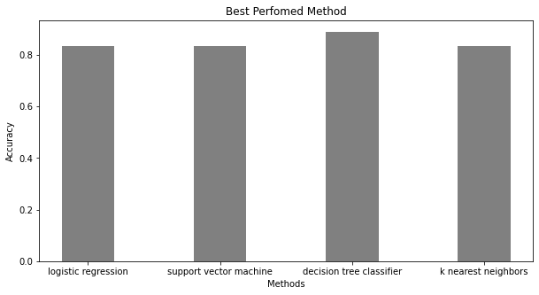
Classification Accuracy
All models has approximately same appearance in the bar plot on the test dataset(small in size of 18 records) at 83.33% accuracy.
This might cause large variance in accuracy in some ML models like Decision tree classifier while repetitive runs.
Due to small size of data it is hard to take decision for good accuracy. Hence, we need more data to determine the best model.

Slide 44
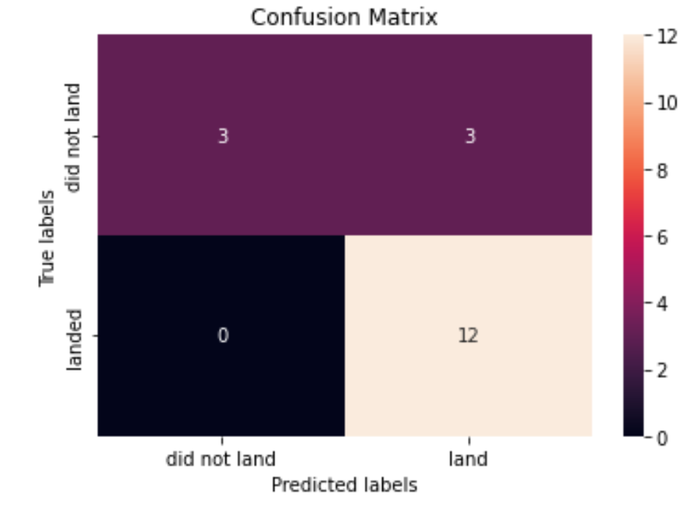
Confusion Matrix
To determine the correct predications, we should start from top left to bottom right boxes.
From the matrix graph, it is visible that all models performed the same for test data but the confusion matrix is the same across all models.
The model predicated 12 successful landings when the label was true for successful landings.
The model predicated 3 unsuccessful landings when the true label was unsuccessful landings.
For the False-Positive case - The model predicated 3 successful landings when the true label was unsuccessful landings.

Slide 45
Conclusions
End Goal : Develop a machine learning model for SpaceY who wants to compete against SpaceX.
The major goal was to build a predictive model that can correctly predict that when stage1 will land successfully is it worth to save $100 million USD.
To make the predictive model, in this project SpaceX public API and SpaceX Wikipedia page are used.
Data collection is done with SpaceX API and Wikipedia page by performing some methodologies, like data collection, web scrapping, data wrangling etc.
Extracted, Transformed and loaded the gathered data into DB2 database.
Created interactive dashboard for visualization using Plotly python library from the data sets from a csv file.
Created machine learning model with an accuracy of 83.33%, which concludes that the landing of stage1 can help in reducing cost to SpaceY company.
By visualization analysis we have found that best locations for launch site, capacity of different booter versions and what are the best landing locations across entire US.
The accuracy could be more accurate if there is more data to build the machine learning model.
However, Successfully generated a machine learning model that predict the successful landings or launch locations site.

Slide 46
Appendix
Github URL for relevant assets that have been created during this project :
https://github.com/kamesh01/Applied-Data-Science---Capstone
Speacilly thanks to all the instructors :
https://www.coursera.org/professional-certificates/ibm-data-science#instructors

Slide 47


